Slide 1

Hostel Gym

Slide 2


Description
This software allows the admin to store and retrive the information about the hostel gym users.
Insert background image
Team members name
Project description
Team Members: Sravan, Amulya, Rishmitha, Vikas

Slide 3







Concept
Custom Reports
Attendance
Student and Trainer Data
Payments
Registration Form
SMS Portal

Slide 4
Project Life Cycle
Requirements
1
Barcode Scanner,Student and trainer data..
Design
2
The above stated requirements are taken as input and an architechture of the system is prepared.
3
Implementation
The design is converted into the source code.
Testing
4
The system is tested and the bugs are identified and modified.
Deployment and maintenance
5
The system is made available for the use and modifications can be made,if any.

Slide 5

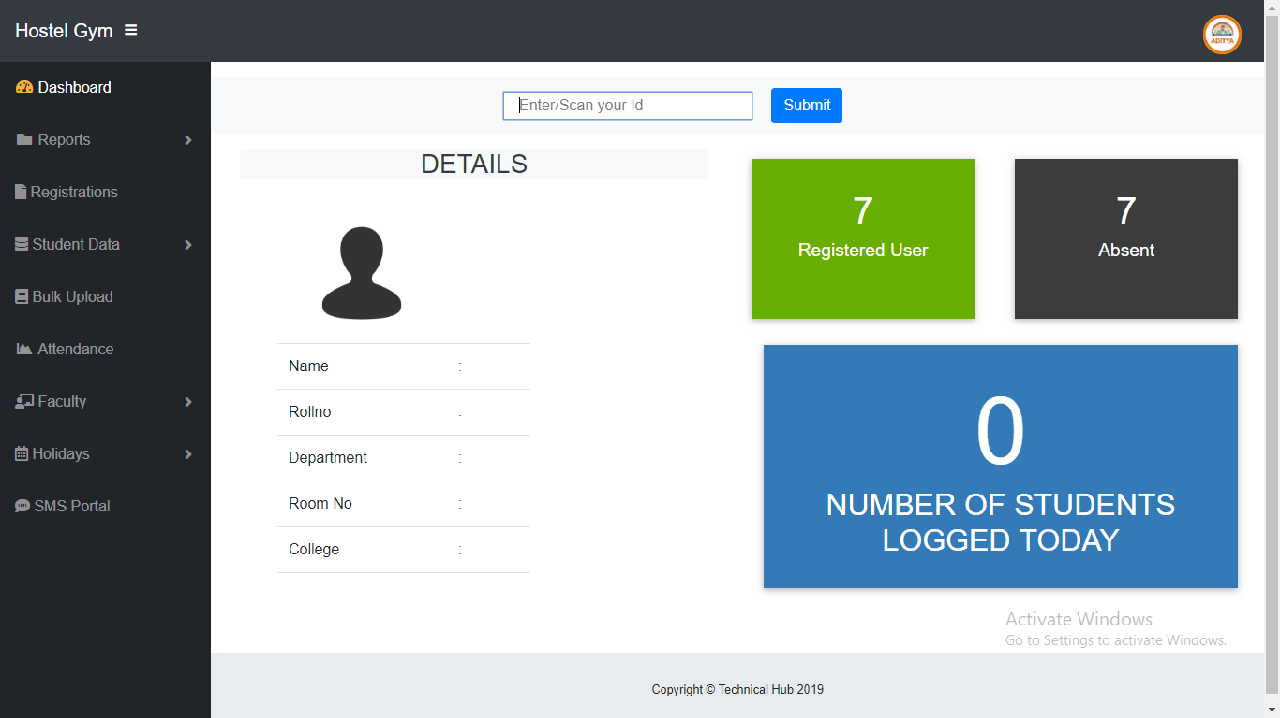
Overview:
The snapshot beside shows the dashboard of the hostel gym which comprises of registered users ,absentees,number of students logged today,and the details of a student logged.

Slide 6

Thank You!
Any questions?
Find me at : jsravan1500@gmail.com

